Slide 1

AST: Audio Spectrogram Transformer
Arxiv (2021)

Slide 2
AST: Audio Spectrogram Transformer [Link]
Background
Addressed problems
CCN – attention hybrid models
CNN have been widely used to learn representations from raw spectrograms for end-to-end modelling
Add a self-attention mechanism on the top of the CNN to better capture long-range global context
Have achieved state-of-the-art (SOTA) results for many audio classification tasks
The success of purely attention-based models in the vision domain
CNN-based models typically require architecture tuning to obtain optimal performance for different tasks
SOTA CNN-attention hybrid models have more complicated architecture with lots of parameters
Research Aim
Build a convolution-free, purely attention-based model for audio classification which features a simple architecture and superior performance.
Achieve better performance with a simpler architecture with fewer parameters.

Slide 3
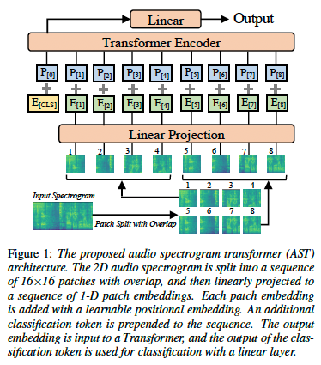
AST: Audio Spectrogram Transformer [Link]
Methodology
Components:
The input audio waveform of t seconds is converted into a sequence of 128-D log Mel filterbank features computed with a 25 ms Hamming window every 10ms. (128 * 100t spectrogram)
Split the spectrogram into a sequence of N 16 * 16 patches with an overlap of 6 in both time and frequency dimension
Flatten each 16 * 16 patch to a 1D patch embedding of size 768 using a linear projection layer
Add a trainable positional embedding (size 768) to each patch embedding
Append a [CLS] token at the beginning of the sequence
Propose an approach for transferring knowledge from the Vision Transformer (ViT) pretrained on ImageNet to AST
propose a cut and bi-linear interpolate method for positional embedding adaptation.
Architecture overview :

Slide 4
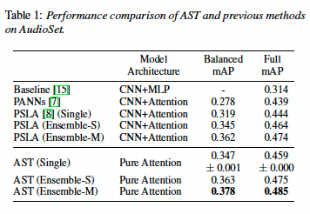
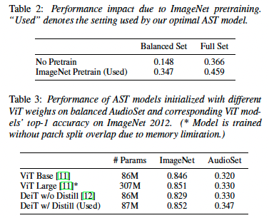
AST: Audio Spectrogram Transformer [Link]
Experiments
Results
Findings
All the single, Ensemble-S, Ensemble-M model outperform the previous best system (CNN-attention hybrid model)
AST work well even when the training set is relatively small
Datasets
AudioSet – a collection of over 2 million 10-second audio clips contains from a set of 527 labels
Focused Tasks
Use weight averaging strategies
Use ensemble strategies
- Ensemble-S: run three times with the exact same
setting, but with a different random seed.
- Ensemble-M: ensemble the three models in
Ensemble-S together with another three models
trained with different patch split strategies.
Evaluation metrics
Mean average precision (mAP)

Slide 5
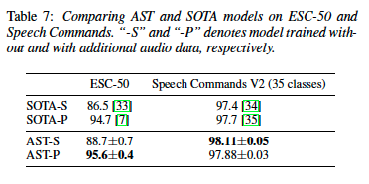
AST: Audio Spectrogram Transformer [Link]
Experiments
Results
Findings
AudioSet pretraining unnecessary for the speech command classification task as AST-S outperforms AST-P.
The input audio length varies from three datasets, and content varies from speech to non-speech, AST achieve SOTA results on all of them.
Datasets
ESC-50 – consists of 2,000 5-second environmental audio recordings organized into 50 classes
Speech Commands V2 – consists of 105,829 1-second recordings of 35 common speech commands
Focused Tasks
Compare AST with the SOTA models in two setting
1. AST-S: train an AST model with only ImageNet
pretraining
2. AST-P: train an AST model with ImageNet and
AudioSet pretraining
Evaluation metrics
Mean average precision (mAP)

Slide 6
AST: Audio Spectrogram Transformer [Link]
Others
Additional experiments and analysis
Impact of ImageNet Pretraining: ImageNet pretraining can greatly reduce the demand for in-domain audio data for AST.
Impact of Positional Embedding Adaptation: reinitializing positional embedding does not completely break the pretrained model, but it leads to a noticeable performance drop. Bi-linear interpolation and nearest-neighbor interpolation do not result in a big difference.
Impact of Patch Split Overlap: the performance improves with the overlap size for both balanced and full set experiments.
Impact of Patch Shape and Size: when the area of the patch is the same (256), 128 * 2 rectangle patches perform better than 16 * 16 square patches. But considering there is not 128 * 2 patch based ImageNet pretrained models, using 16 * 16 patches is still the current optimal solution.
Summary
AST feature a simple architecture and superior performance
The final performance of AST on all three datasets indicated the potential for AST use as a generic audio classifier.

